Slide 1
Process and Analysis

Slide 2
Data Selection
https://www.kaggle.com/datasets/jaidalmotra/pokemon-dataset
I chose this dataset because I have a small interest in Pokemon.
It’s in CSV format which is convenient.
I downloaded it to my PC and placed it in my repository.

Slide 3
Question to be Answered/General Pokemon Explanation
The question I was looking to answer via data analysis was ‘what primary types of pokemon have the most total stats and what types have the least’. For those who don’t know anything about pokemon, pokemon are separated into different ‘types’ like water, fire, flying, etc. For example, the most recognisable pokemon, Pikachu, is an electric type. In game, stats refer to the overall strength of a pokemon. In Pokemon, not all pokemon types are created equal.

Slide 4
Data Exploration
Then I used matplotlib to create a graph to visually represent the specific data I’m trying to look at.
type1_total = df[['type1', 'total']]
type1_mean_total = type1_total.groupby('type1').mean()
plt.figure(figsize=(12, 6))
plt.scatter(type1_mean_total.index, type1_mean_total['total'])
plt.title('Mean Total by Type 1')
plt.xlabel('Type 1')
plt.ylabel('Mean Total')
plt.xticks(rotation=45) # Rotate x-axis labels for better readability
plt.grid(True)
plt.show()
I used pandas in python in order to answer my question.
import pandas as pd
df = pd.read_csv(‘Pokemon.csv’)

Slide 5
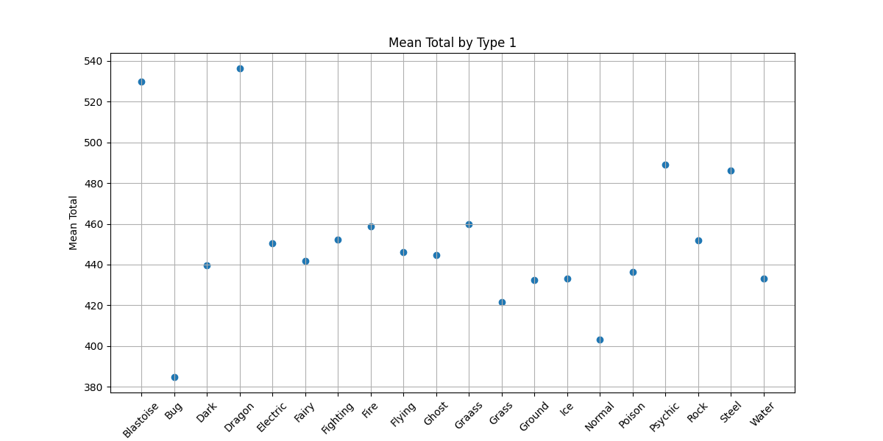

Slide 6
Blastoise Column Removal
Blastoise is a Pokemon and not a typing, so something must be incorrect in the dataset. I went on to remove the Blastoise column from my dataset.
df2 = df[df[‘type1’] != ‘Blastoise’]
type1_total = df2[[‘type1’, ‘total’]]

Slide 7
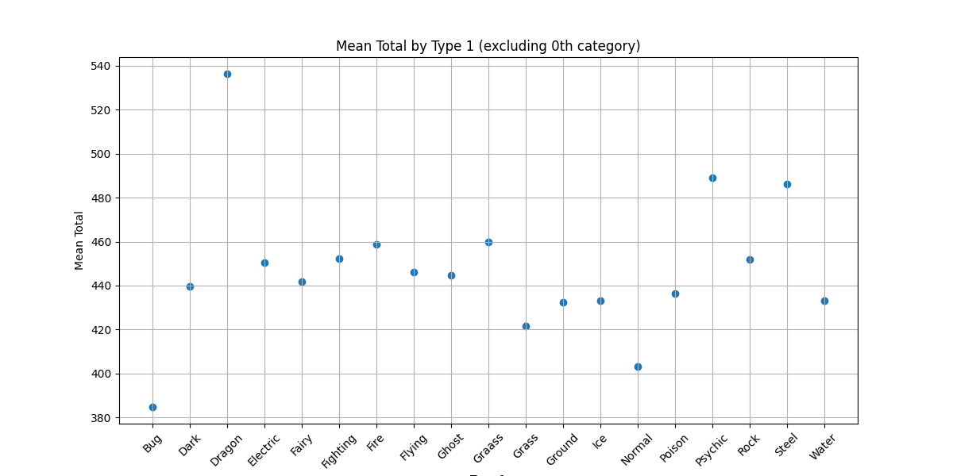

Slide 8
Analysis
The clear winner of the total stat value is the dragon typing with an average total stat nearing 540.
The clear loser of the total stat value is the bug typing with an average barely above 380, while normal typing is second worst at slightly above 400.

Slide 9
HTML Stuff
I’ve never used html, so I had ChatGPT help me do a quick html to fulfill that requirement of the assignment. I admit I’m not sure what is being asked. It’s in the github repository.

